Slide 1

Software Personnel management system
By The Marvel Coders

Slide 2
The Marvel coders
Pruthvi.M
17691A05A2
Mohan Vamsi Reddy.K
17691A0577
Madhusudan.R
17691A0565

Slide 3
ABSTRACT
The main objective of the project “Software Personnel Management System” allows employees to record time card electronically and lets automatically generates pay slips based on no of hours worked.
The software can be installed on employee device where they can access and edit their own personnel data only. They can even know details like for how many hours they have worked and payment details.
Database of the employee information is maintained and examined by administrator. Information includes employee name, id, phone number, date of join, salary details etc.
Only administrators will have accesses like adding new employees, deleting employees and generating reports of the employees. This project is developed with help of Java Swing as a front end and oracle as back end. The application software Rational rose is used.

Slide 4
Introduction
The Software Personnel Management System is an interface between employee and an administrator. It aims to improve the efficiency in the generation of pay slips and reducing the complexities involved in it .

Slide 5
scope
Software system allows admin to manage its employee in a better way.
When needed it will take less time to give the details of an employee and his contributions.
It will also help admin to maintain data in a professional manner rather than records and papers.

Slide 6

Software requirements
Front End using Java-Swings.
1
Back End using Oracle.
2
Rational Rose Tool
3

Slide 7

HARDWARE REQUIREMENTS
Desktop
CPU of at least 2Gb RAM and windows operating system
Graphic Card

Slide 8
Designing part

Slide 9
Structural things and diagrams

Slide 10
Class diagram
Class diagram is used to model the structure of a software.
Contents:
Classes , interfaces , collaborations, relationships, note, grouping things, annotation things.
Structural things: classes.
Annotation things: Note.
Relationships: Association, Generalisation, Realisation, Dependency.

Slide 11
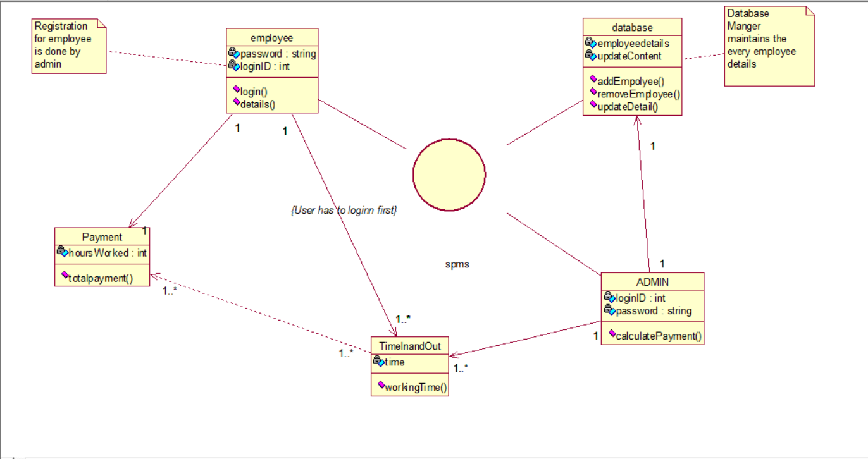

Class diagram

Slide 12
Object diagram
Object diagram models the instance of classes from the class diagram.
Object diagram represent the static part of the system.
Contents: objects, links, annotation things, grouping things.

Slide 13
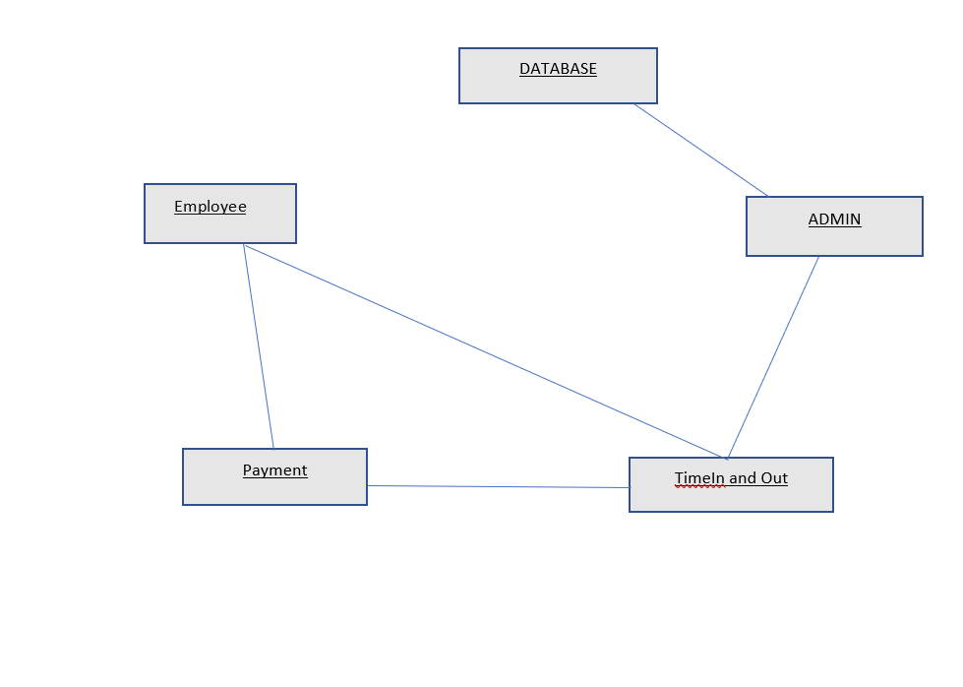
Object diagram

Slide 14
Component Diagram
It models the physical aspects of a system.
Contents:
Component, interface, relationships, grouping things, annotation things.

Slide 15
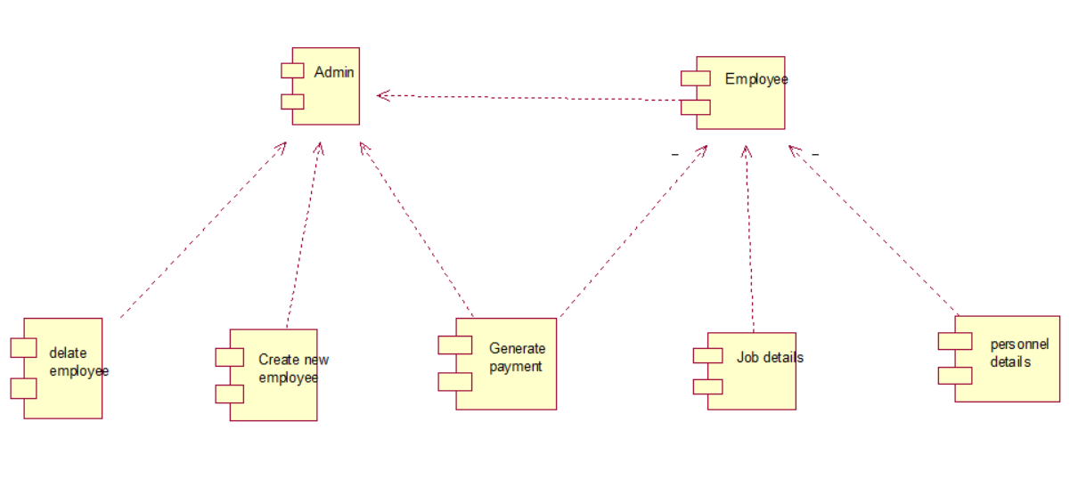
Component diagram

Slide 16
Deployement diagram
It represents the static view of a system.
A node is a physical element that exists at run time used to perform some computational operations.
Contents:
Nodes, links.

Slide 17
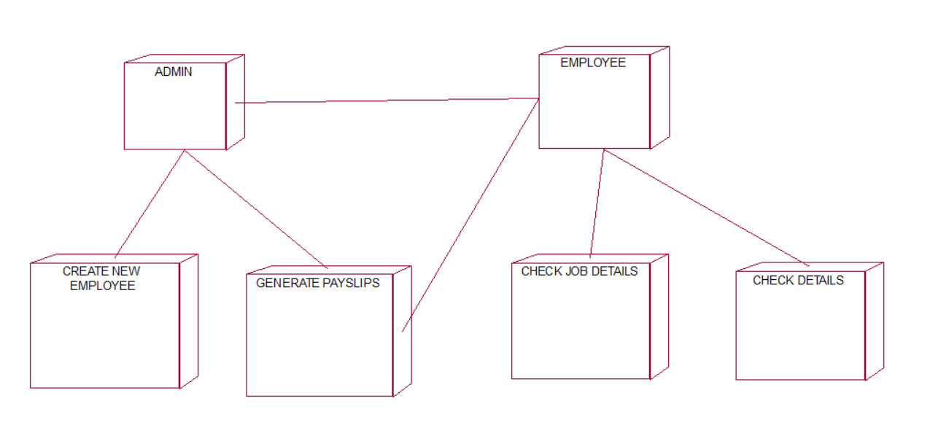
Deployment diagram

Slide 18
Behavioural things and diagrams

Slide 19
Usecase diagram
Usecase diagram is used for modelling dynamic aspects of a system.
It specifies what the system does.
Contents:
Usecases, actors , relationships, annotation things, grouping things ,constraints, tagged values.
Relationships: unidirectional association.

Slide 20
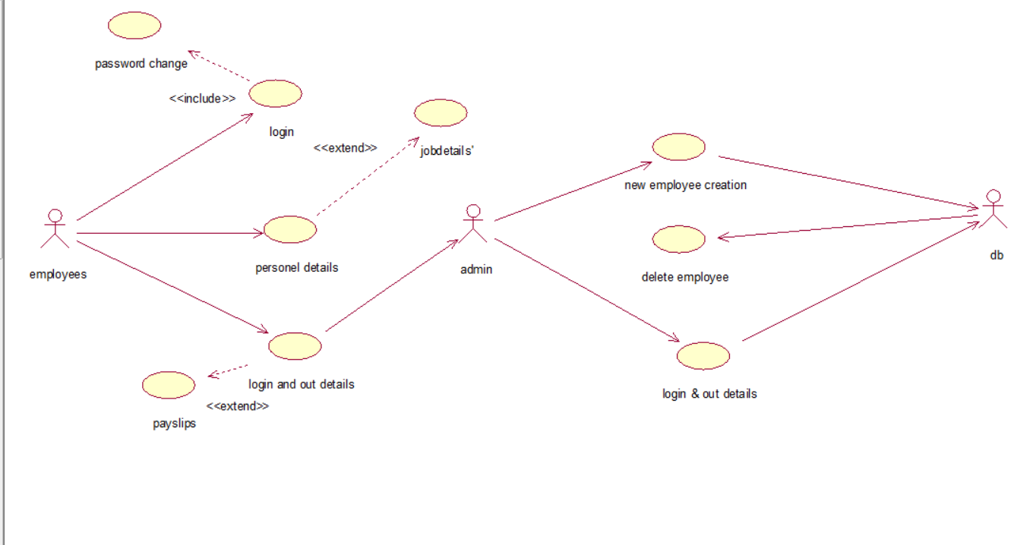
Usecase diagram

Slide 21
Interaction diagram
Interaction diagram is used to design the dynamic aspects of the system.
Contents: objects, links, messages
Sequence diagram: Sequence diagram is one of the two interaction diagrams. It emphasises on time ordering of messages.
Collaboration diagram: Collaboration diagram gives structural organisation of objects.

Slide 22
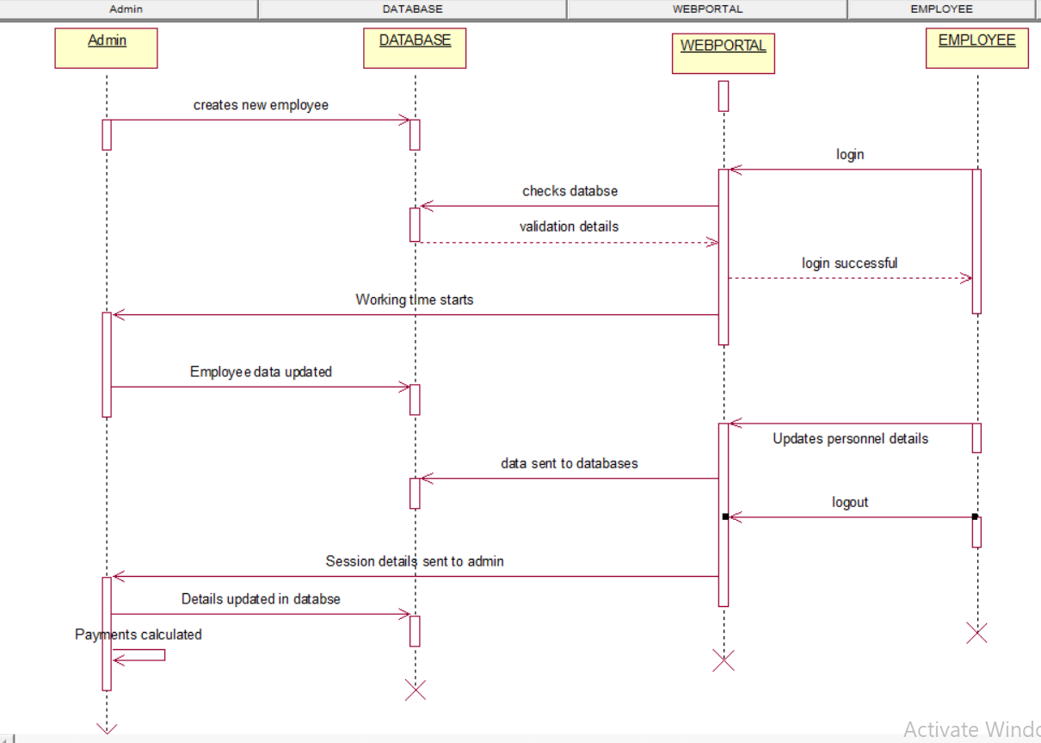
Sequence diagram

Slide 23
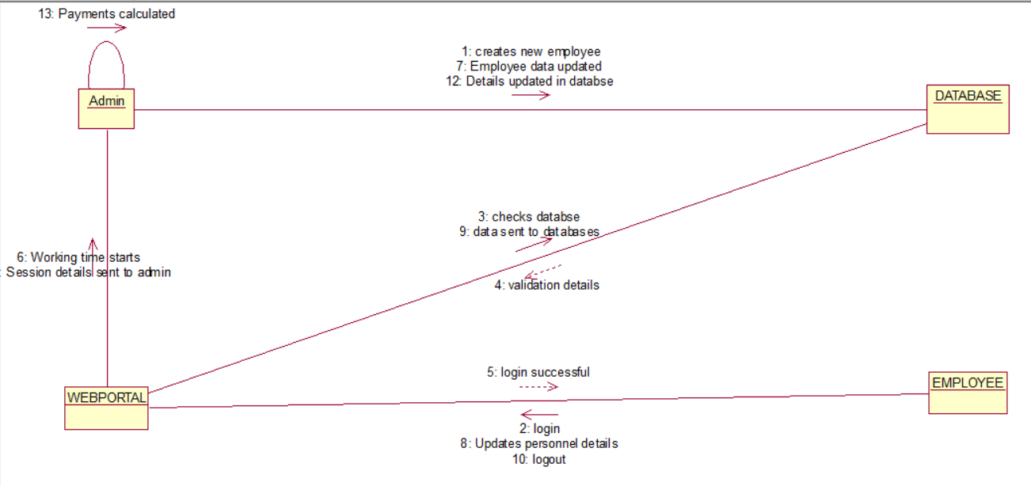
Collaboration diagram

Slide 24
Activity diagram
Activity diagram is similar to flow chart. It represents flow of execution from one activity to another activity.
Contents:
Start, end, action, branching, fork, join, transition, swimlane.

Slide 25
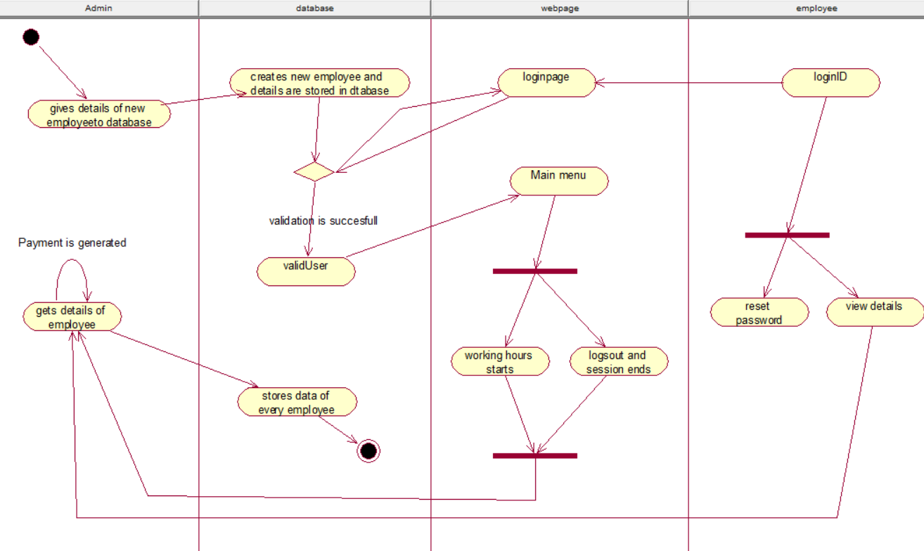
Activity diagram

Slide 26
Statechart diagram
The statechart diagram is a state machine focussing on the flow of control from one state to another state.
Contents: initial state, final state, state , transition.

Slide 27
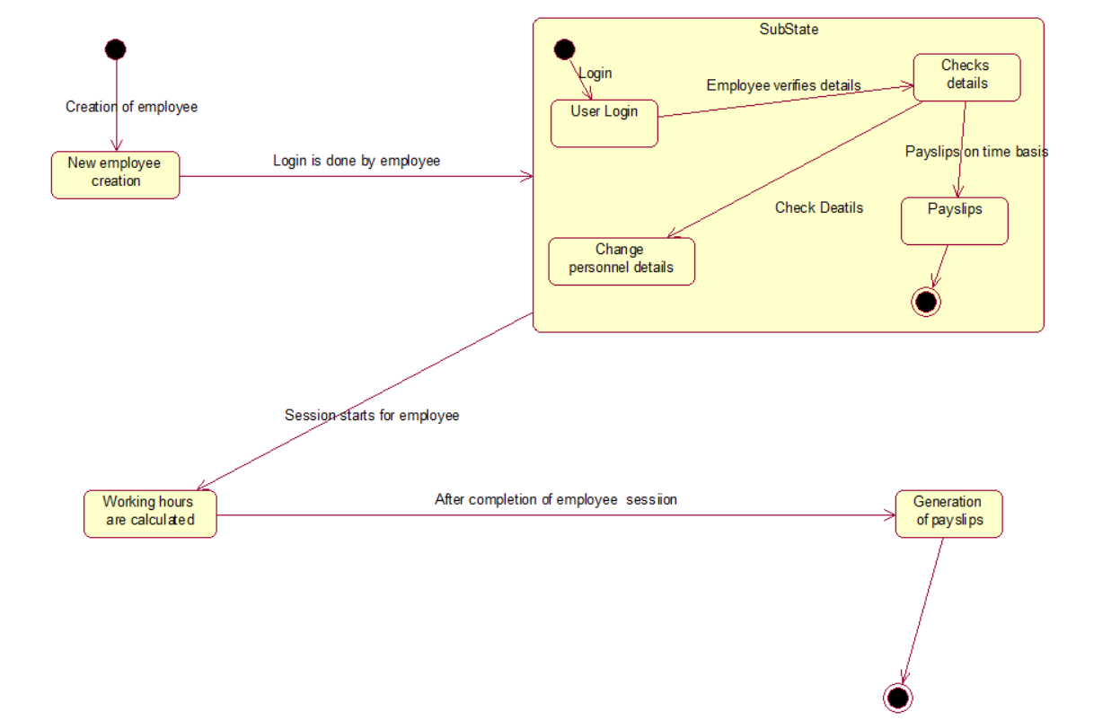
State chart diagram

Slide 28
implementation
MODULES
Creating Credentials
Employee Checking and Changing Details
Payslips Management
Adding and Deleting of Employee
Checking Details of Employee

Slide 29
Creating Credentials
The credentials for a employee to login are given and created by admin/ employer. The account is the main key for storing details of employee and it helps employee to check his details. The admin has a account given by the database manager.
Employee Checking and Changing Details
Employee can check his personnel details, job detail and can change his personnel details. If employee wants to change is details he can simply do it while the application is opened.
Payslips Management
The Payslips for each employee are calculated based on his working time i.e. how much time does the application is opened in background. Payslips data is sent to admin.

Slide 30
Adding and Deleting of Employee
It is done by employer by logging in to his account. Employer has a privilege of changing certain details of employee only.
Checking Details of Employee
Employer as the access to check details of every employee and all employee details are given to employer from database.

Slide 31
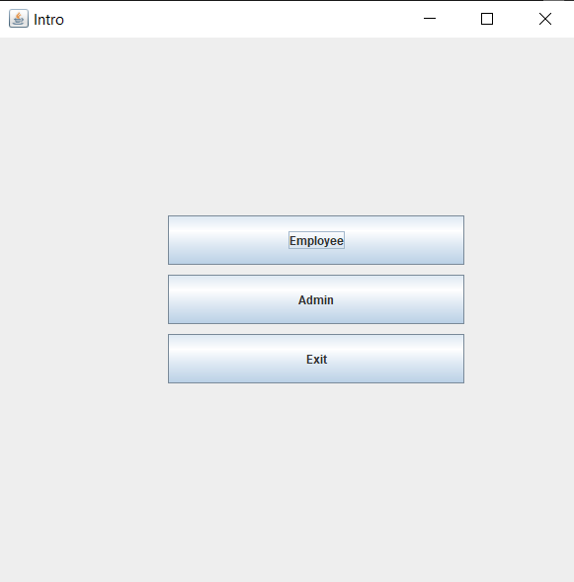
Intro page

Slide 32
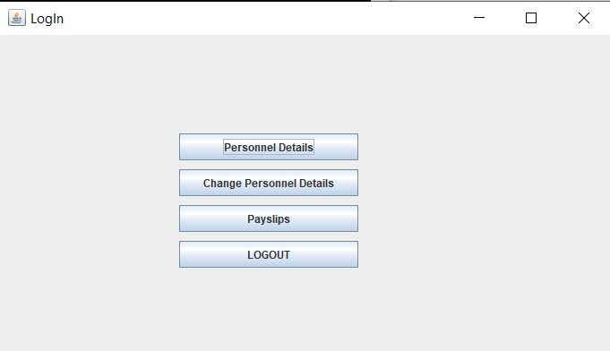
Employee’s main menu

Slide 33
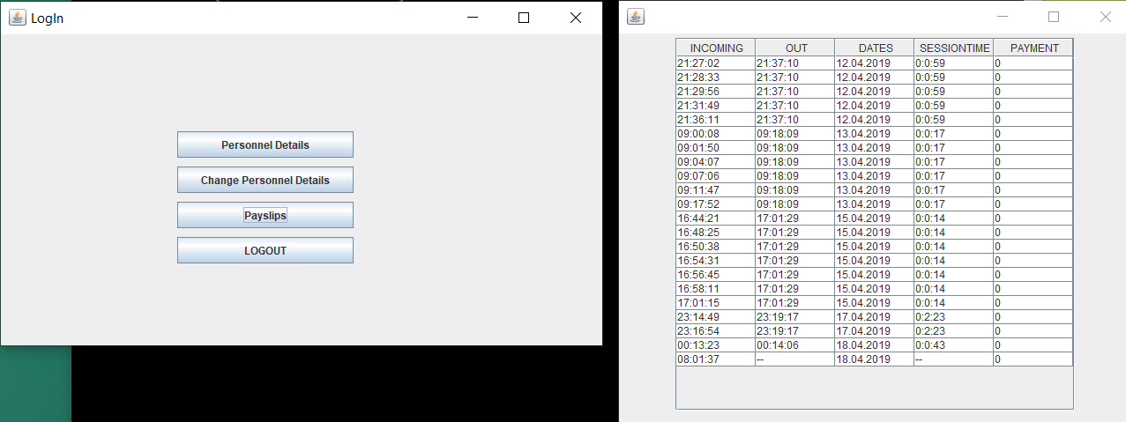
Employee viewing his payslips

Slide 34
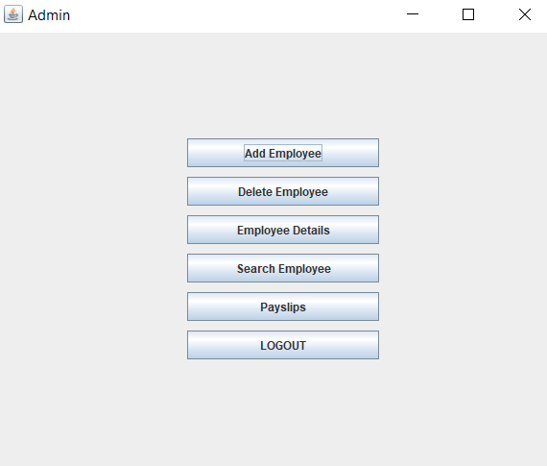
Employer’s main menu

Slide 35
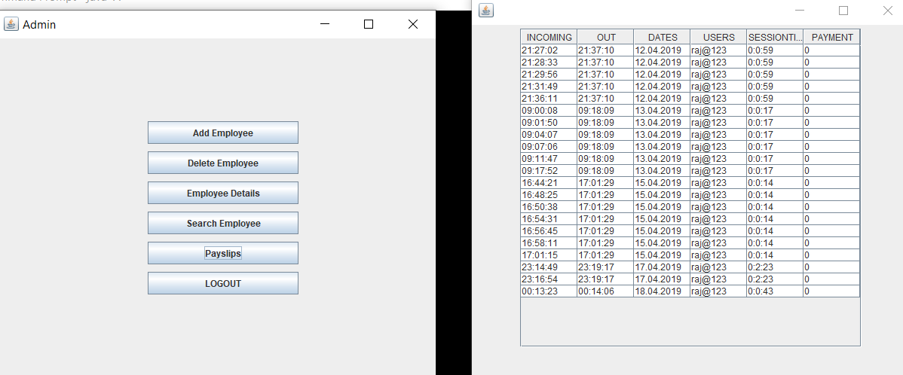
Employer viewing payslips

Slide 36
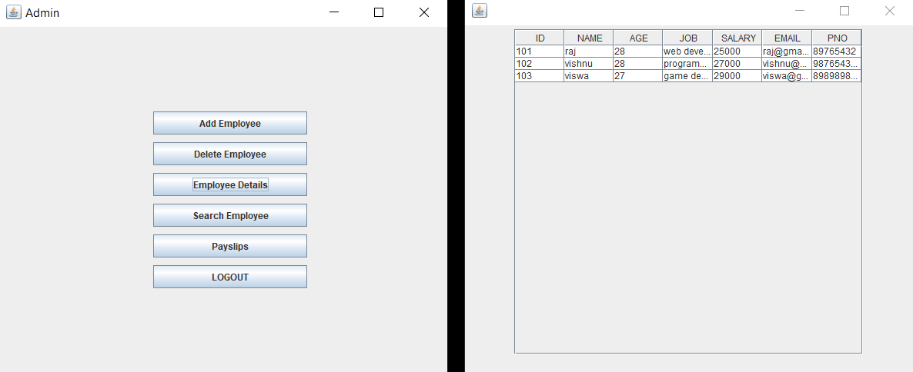
ALL employees details

Slide 37
conclusion
This project sets a Platform to all Employees and Employers to know the exact days they have worked and the exact amount of salary they will be receiving at the end of the month without any errors or faults in the pay slip. This system gives a clear picture to every worker who wants to know how they are being paid.
It also helps to maintain data of many employees without any extra maintenance.
It has good role to play when we have a large number of work force.

Slide 38

Thank you

